Slide 1

>>>>> Before You Begin <<<<<
Less is more
Avoid paragraphs and long sentences
Use the 5x5 rule — max of 5 lines, 5 words each
One idea per slide
Notes:
Esri Corporate Template-Dark v4.0
September 29, 2021

Slide 2

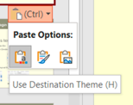
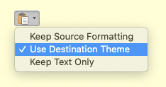
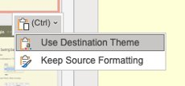

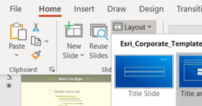
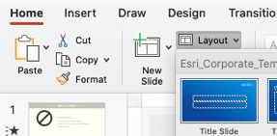
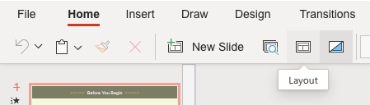
>>>>> Before You Begin <<<<<
How to apply this template
Copy existing slides into this file
When pasting, choose Use Destination Theme
Adjust your slides: titles are now larger and lower on the slide for better visibility
For consistent title placement, you may need to select a layout from the Layout menu
For a brief video tutorial, click here
Windows
Mac
Web
Windows
Mac
Web

Slide 3

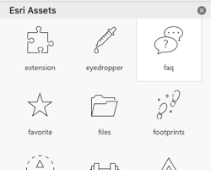
>>>>> Before You Begin <<<<<
Design resources
Icons
Load Esri-created icons straight into your deck!
From the Home ribbon above, click Esri Icons
Presentation Resources [link]
Diagrams, Tables and Timelines [link]
Esri Design Template
Windows [link] | Mac [link]
Backgrounds [link]
Strategic Presentations [link]
Stock photos
Adobe Stock images are available. See the details.

Slide 4


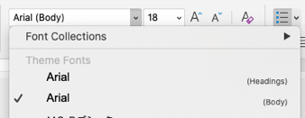
>>>>> Before You Begin <<<<<
Arial or
Use Arial font everywhere
Pick Arial [Headings] or [Body] from the top of the font list
See FAQ “Theme Fonts” for details [link]
Avenir Next is no longer supported
See FAQ “Arial or Avenir Next” for details [link]

Slide 5


Presentation Title
Presenter Names
2022 ESRI DEVELOPER SUMMIT
Notes:
2022 Esri Developer Summit

Slide 6



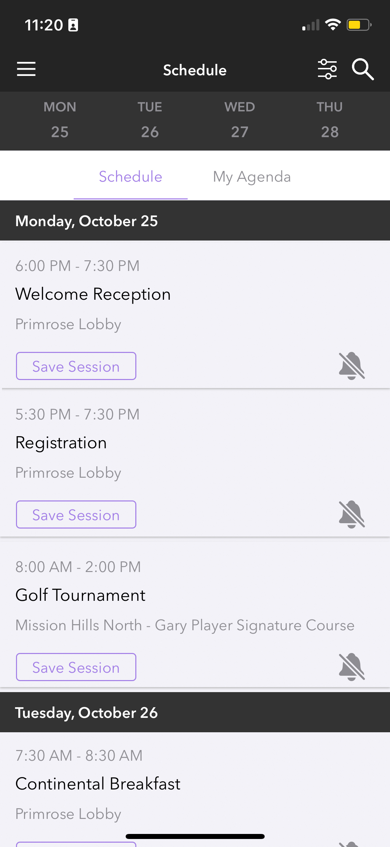
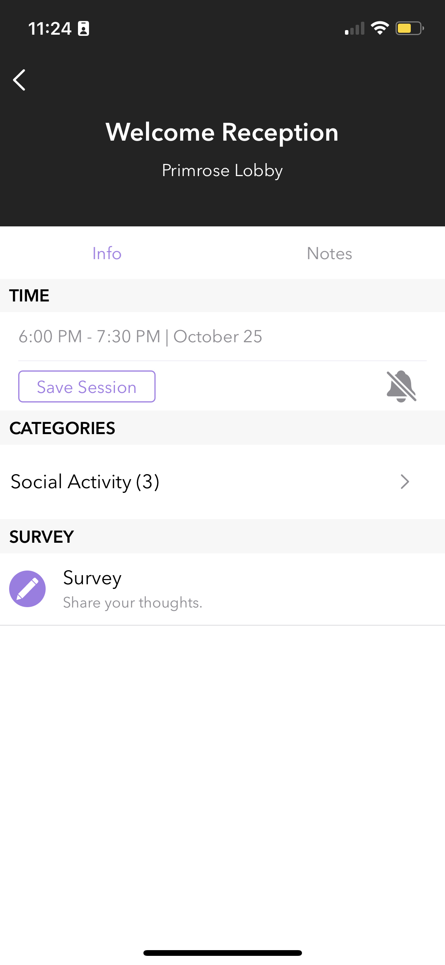
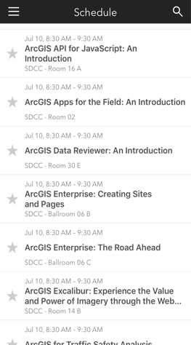
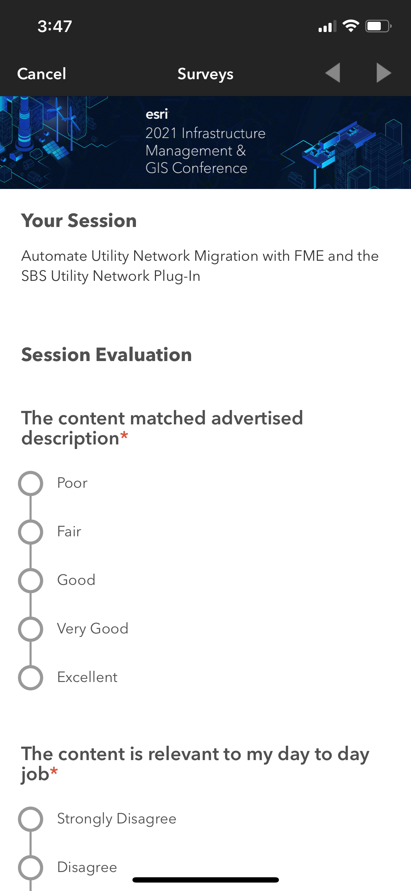
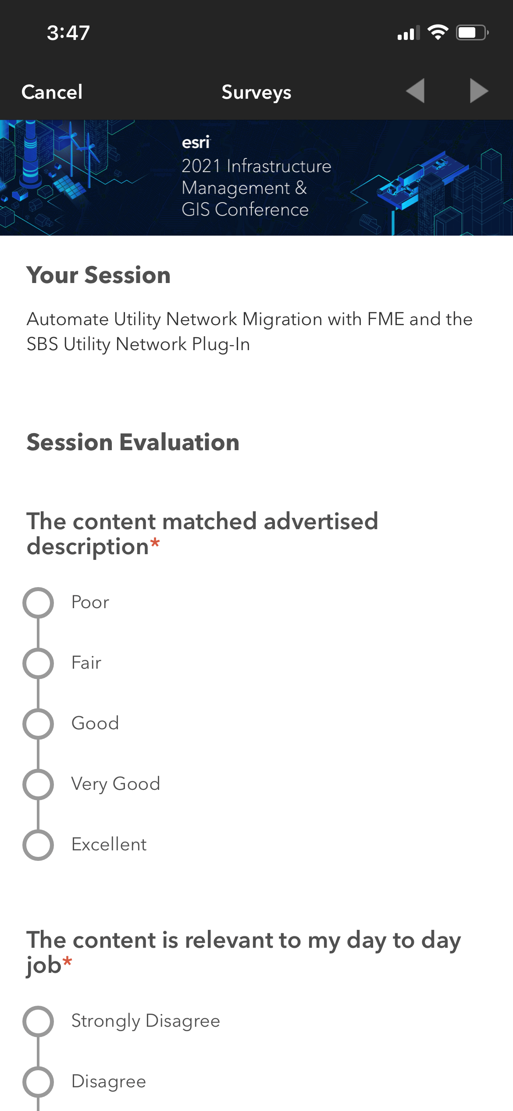
Please Share Your Feedback in the App
Download the Esri Events app and find your event
Select the session you attended
Scroll down to “Survey”
Log in to access the survey

Slide 7



Copyright © 2022 Esri. All rights reserved.

Slide 8
Presentation Title
Presenter Names
2022 ESRI DEVELOPER SUMMIT
Notes:
2022 Esri Developer Summit

Slide 9

Headline
Subhead
Bullets

Slide 10

Headline
Subhead
Bullets

Slide 11

Section Header
Section Subhead

Slide 12

Section Header
Section Subhead

Slide 13

Demo Title
Demo Presenter

Slide 14
Please Share Your Feedback in the App
Download the Esri Events app and find your event
Select the session you attended
Scroll down to “Survey”
Log in to access the survey

Slide 15
Copyright © 2022 Esri. All rights reserved.

